Slide 1
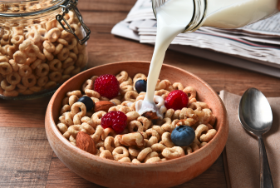
NEW Pricing Strategy
Chia-Hsien Ho, Sayaka Kuwayama

Slide 2
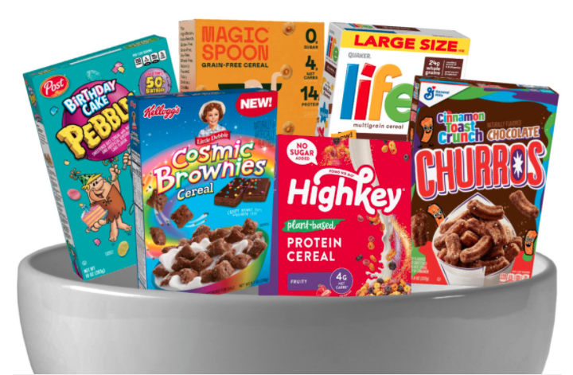


Background
Market Presence: 30.01%
Kinds
Family: $2.80
Kids: $2.68
Pricing strategy
Competitive pricing
→ “better” prices

Slide 3
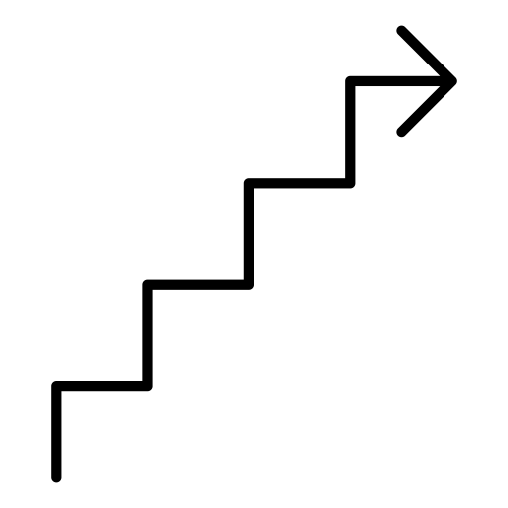
Steps
Exploratory Data Analysis
Pricing Setting
Model and Predictions
→ Estimated Profits

Slide 4

Exploratory
Data Analysis (EDA)
Notes:
(skip) To begin with, we perform exploratory data analysis to get a sense of our data before we do any modelling.

Slide 5
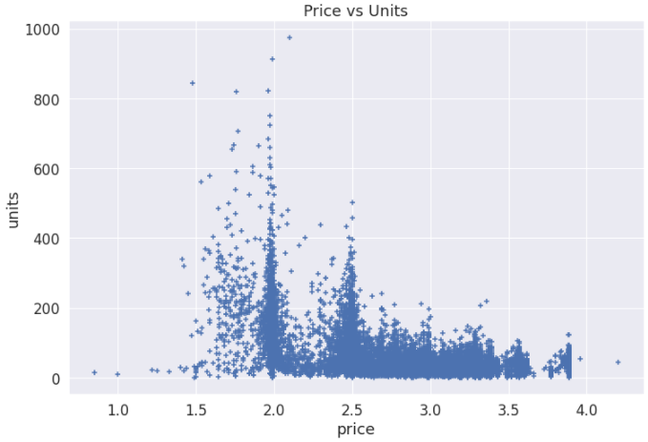
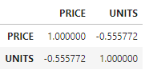
Price v.s Units
Correlation Matrix
Notes:
First, let’s check the scatter plot between price and units sold. Each point stands for one transaction, and there are a total of almost 36 thousand transactions from 2009 to January of 2012.
We can see that the most of the transactions fall between $2 to around $3.5, and the distribution is left skewed. We can also observe a higher units sold per transaction when the price is set at around $2.
Moreover, price and units are 55% negatively correlated, which makes sense that a higher price tend to have a lower demand.

Slide 6
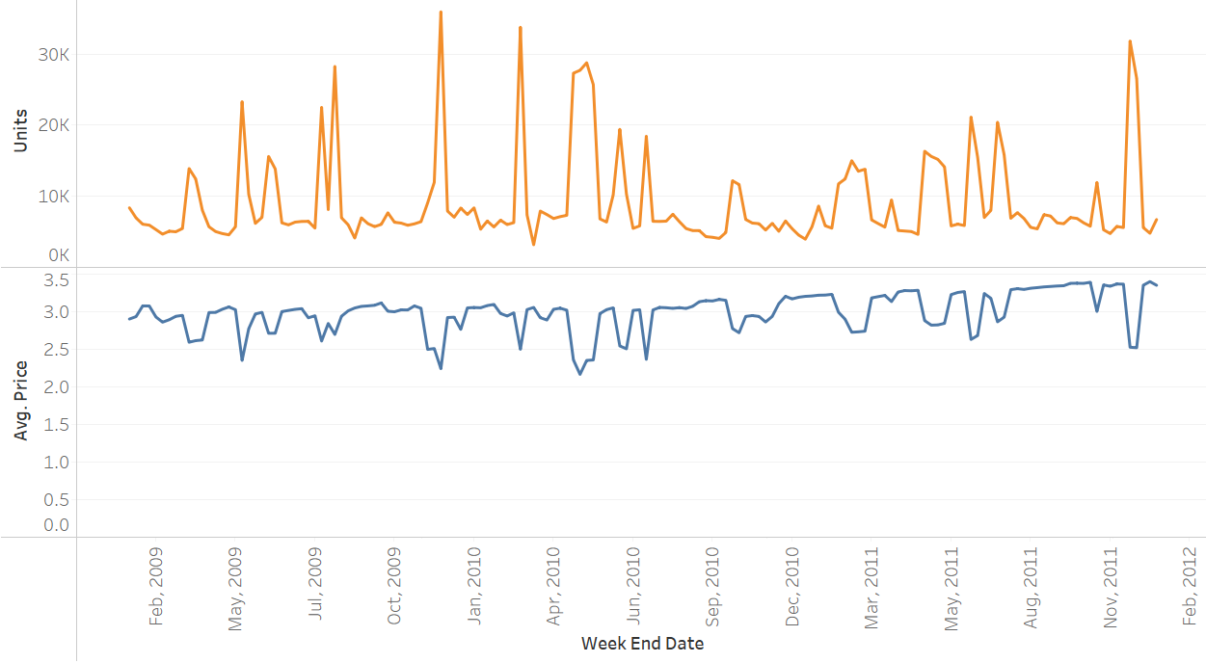
Price & Units Over Time
Dec 2009
Feb 2010
Dec 2011
May 2009
Dec 2009
May 2010
Notes:
Next we plot the sum of units sold and average price over time. (click) Two of the peak for the most units sold are in December, which is reasonable since there’a a Christmas holiday.
(click) The price trend is basically contrary to the units sold. May and December in 2009 have the lowest price.
But interestingly, December 2010 doesn’t seem to have an increase in the sales, and the price during that month remains flat throughout the winter.
We’ll find the reason why in the next few slides.

Slide 7
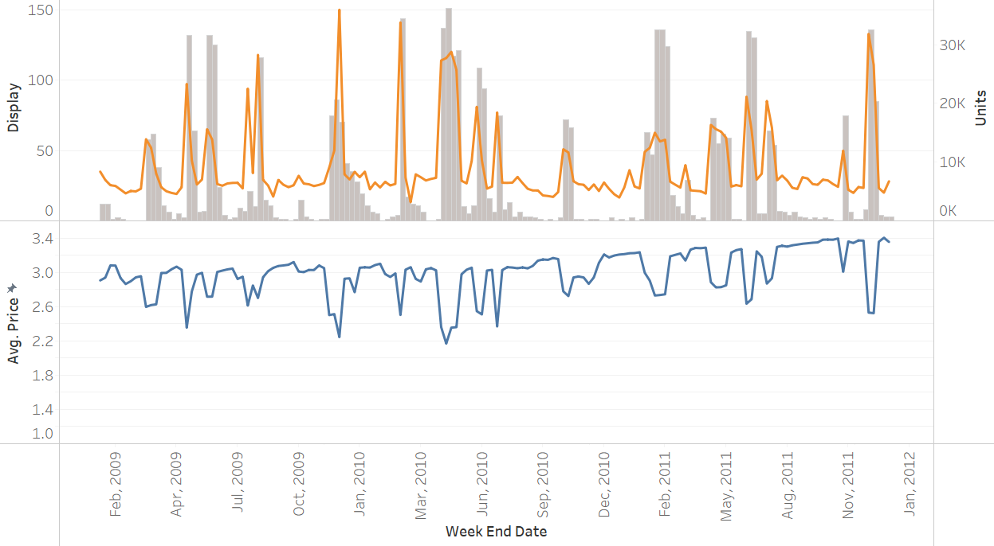
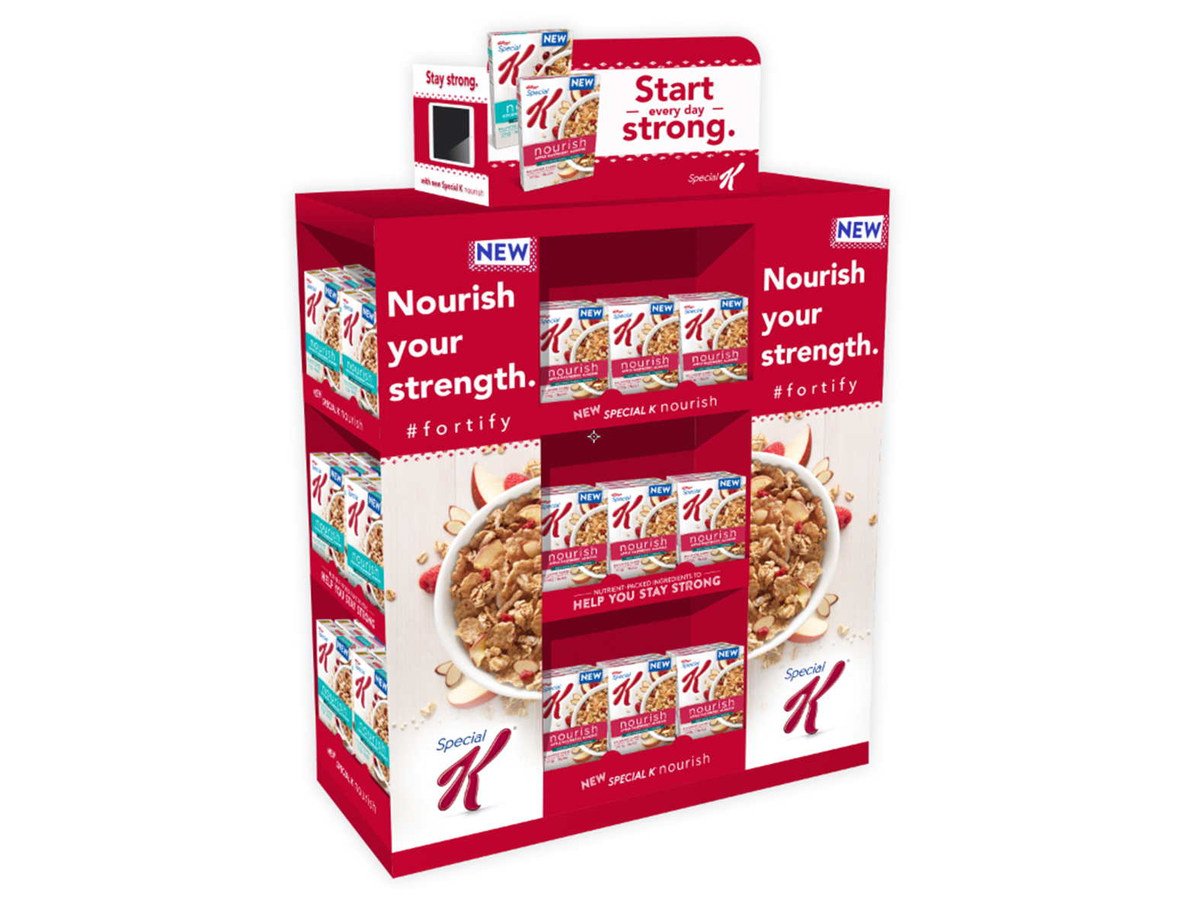
Price & Units Over Time (w/ display)
Notes:
We added the gray bars in the plot, which means the the number of transactions in the week with the cereal being displayed and promoted in the store.
The trend of these number of display is similar to the trend of the sales, therefore the display promotion can possibly drive more sales.
We can now again see that in december 2010, there’s not too much of display promotion.

Slide 8
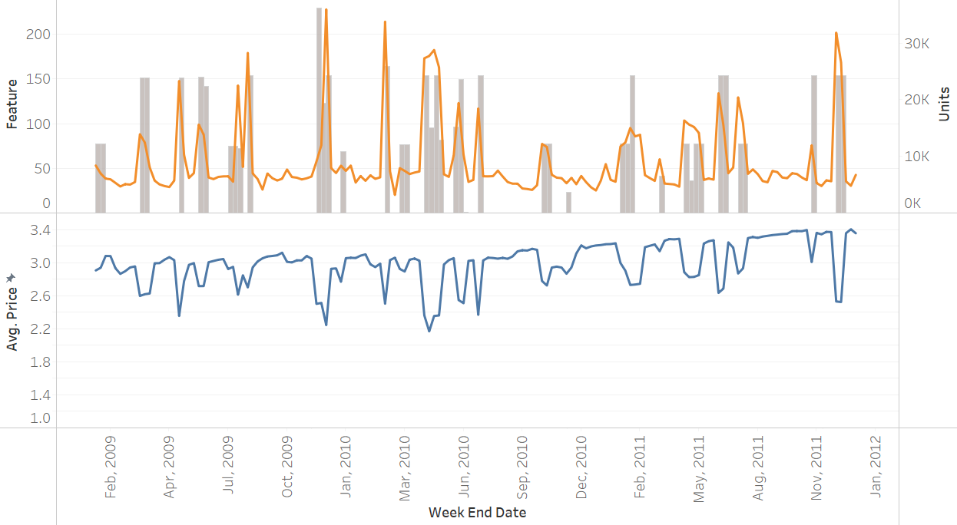
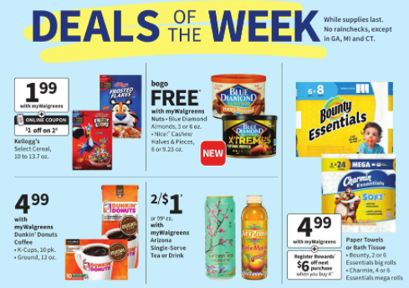
Price & Units Over Time (w/ feature)
In-store circular example
Notes:
Similarly, this time we change the gray bars to the number of transactions with the cereal being featured in store, which means that whether the product was included in the in-store circular.
The bars also seem to have a positive effect on the sales. And again, we’re not doing promotional featuring in December 2010.

Slide 9
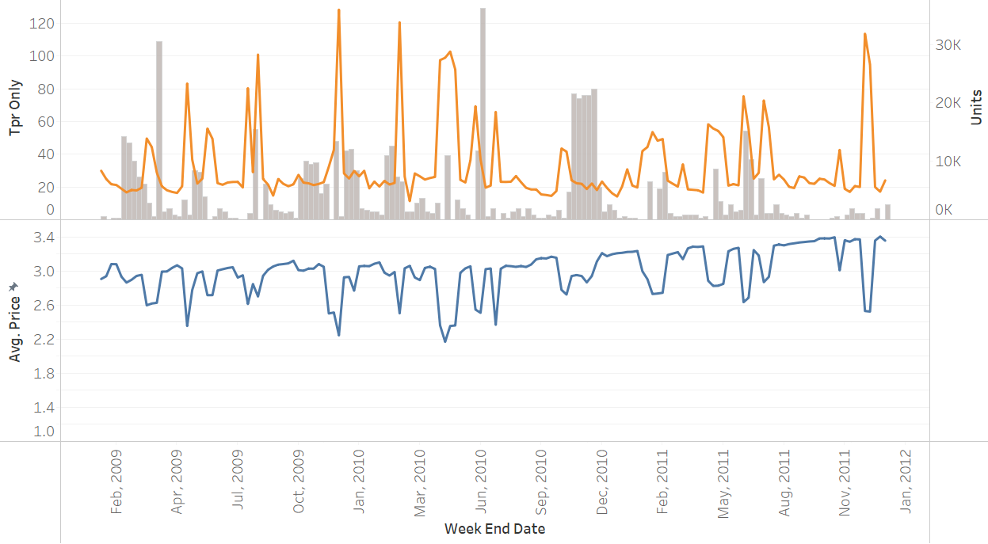

Price & Units Over Time (w/ Tpr Only)
Notes:
Finally, we change the gray bars to the number of transactions with a temporary price reduction, and the reduced price was shown on the shelf tags only, without a display or any advertisement.
The bars don’t seem to follow the sales trend or the price trend.

Slide 10
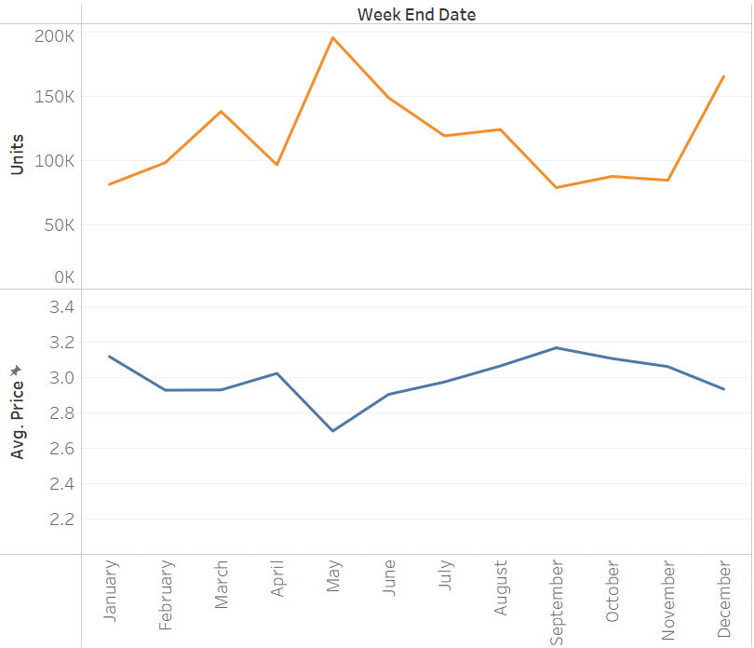
Price & Units by Month
Notes:
We also plot the price and units sold by month to check if there’s a seasonal effect
From the plot, we can see that May and June have a higher sales, and then starts to drop throughout the Fall and Winter, except December due to the Christmas holiday.
Therefore, this seasonal effect should be something we should take into consideration.

Slide 11
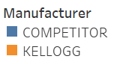
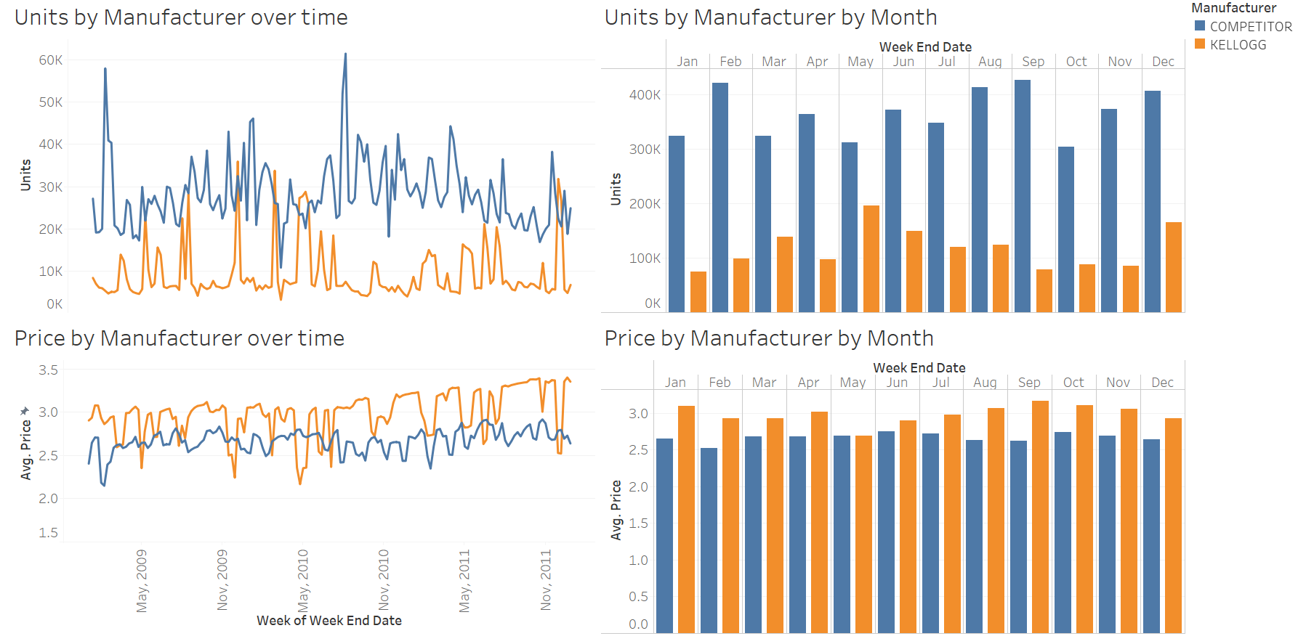
Kellogg’s v.s Competitors
Notes:
We would like to know how well Kellogg’s is doing compared to our competitors.
It looks like the sales trend tend to be contrary, or complementary, which makes sense that when we lower our price, we attract more customers and drives more sales from our competitors.

Slide 12
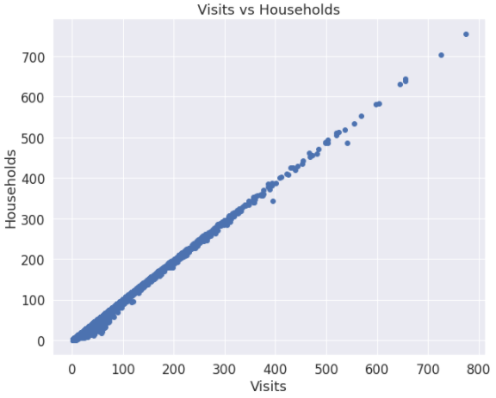
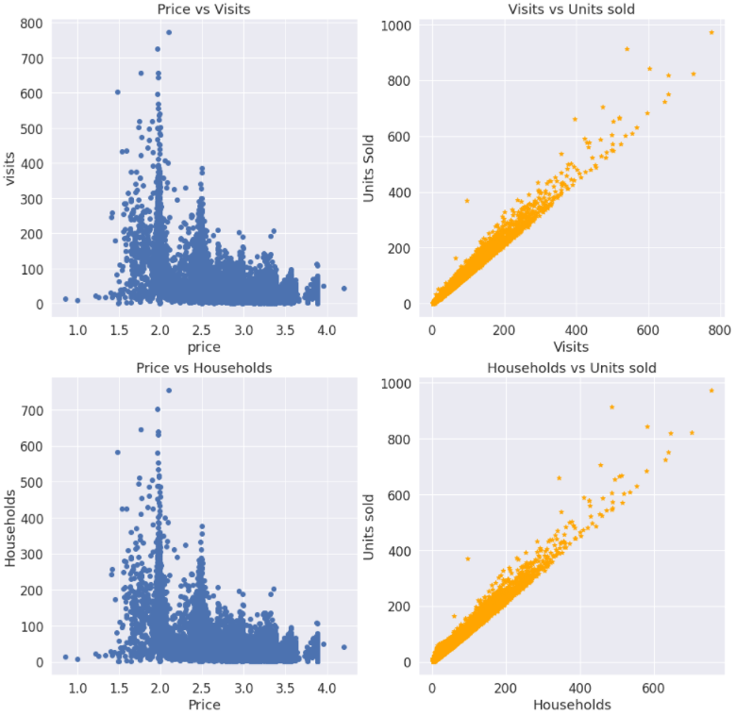
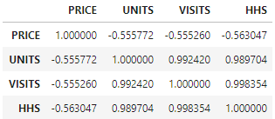
Visits & Households
highly correlated!
Notes:
In this slide, the ‘visits’ variable shows the number of unique purchases that included our cereal product, and the “households” basically means the number of households per transaction.
(click) Both variables are highly correlated with the units sold. And these two variables are also almost 100% correlated.
This should be an issue that we be aware of later in data modelling.

Slide 13
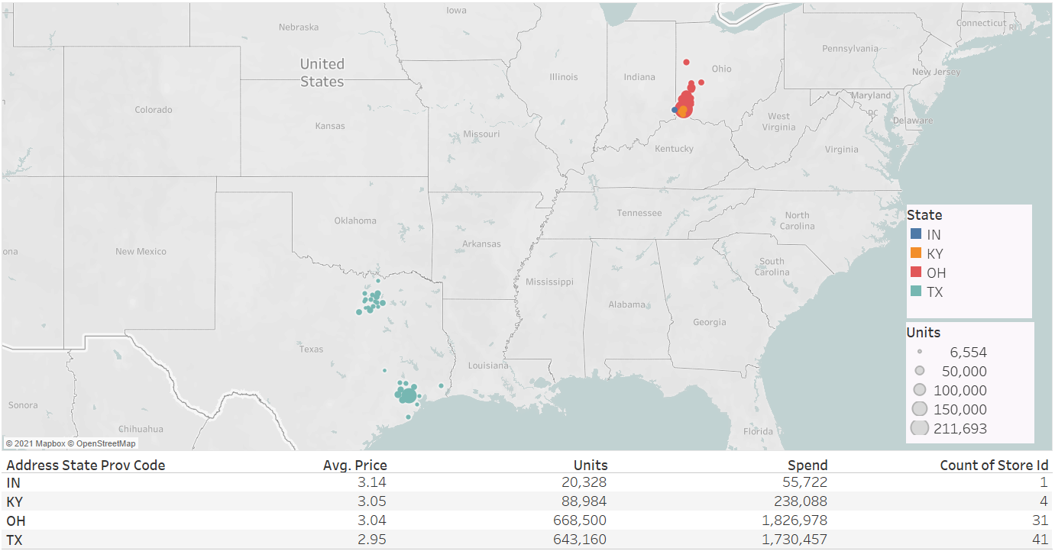
Units Sold
by State
Notes:
Let’s take a look at the map and the statistics by geographic factors. The dataset only contains the stores in four states, and there are a lot more stores in Texas and Ohio.
There are only 4 stores in Kentucky and 1 in Indiana, and the locations are very close to the state border next to Ohio.
So the total sales are really different in these states, and the average price is the highest in Texas and the lowest in Indiana.

Slide 14
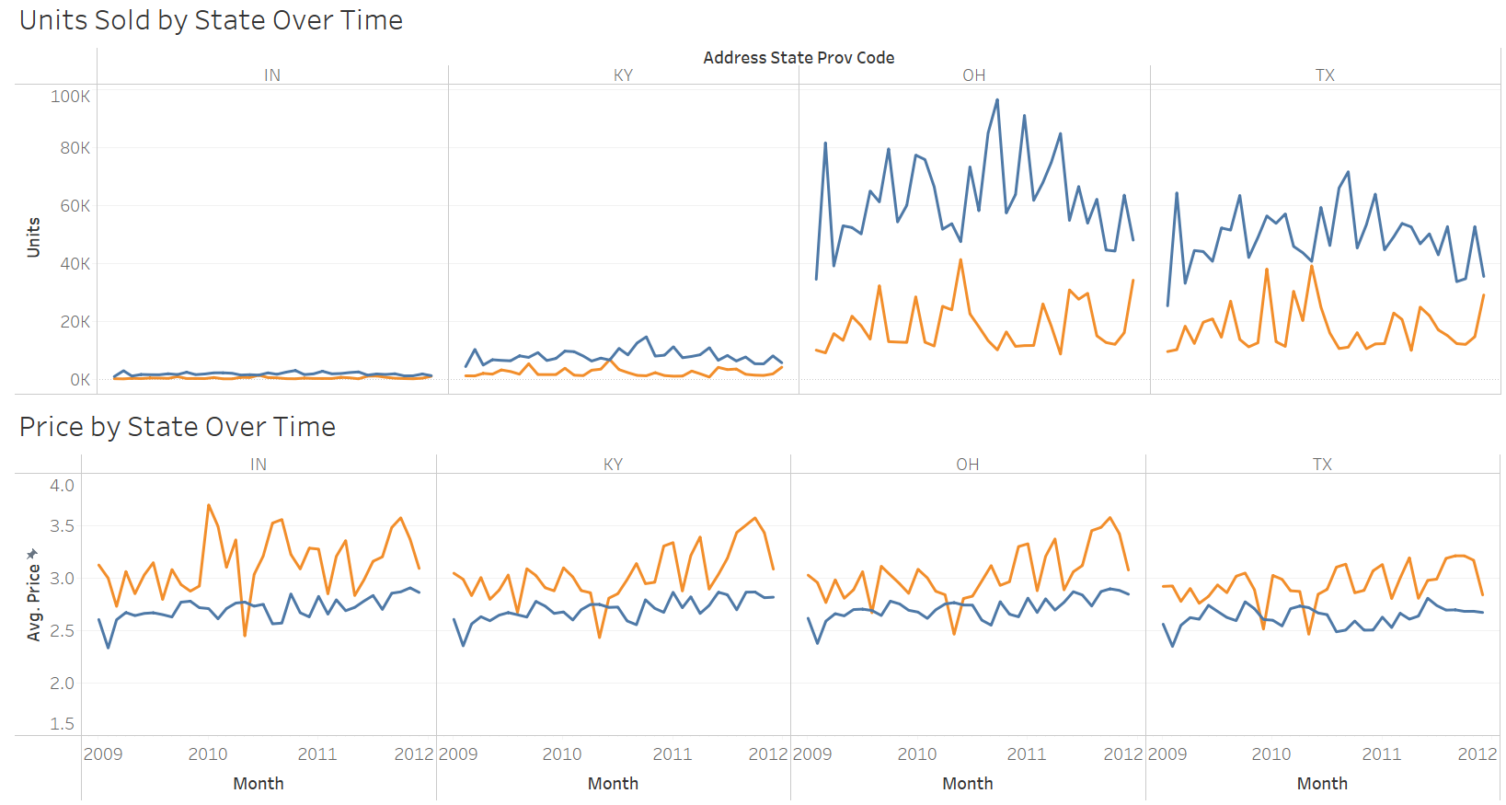
Kellogg’s v.s Competitors by State
Notes:
Here is the comparison between us and the competitors by looking at different states over time.
And again, the sales and average price are mostly contrary in the four states

Slide 15
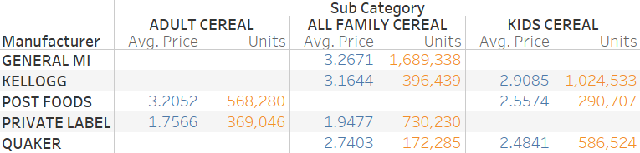

Sub-Category by Manufacturer
TARGETING “Family” and “Kids” Cereal
Notes:
Finally, we want to check the product sub-category and also compare with our competitors. Kellogg’s is targeting only the family and kids cereal,
and it is clear that Kellogg’s is doing really well especially on the kids cereal. The sales is almost twice more than that from Quaker, which is our main competitor
for kids cereal, and the average price is relatively much higher too.
https://markeingchocos.wordpress.com/2014/09/26/segmenting-targeting-and-positioning/

Slide 16
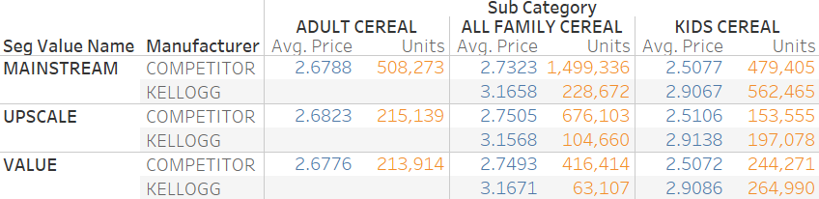
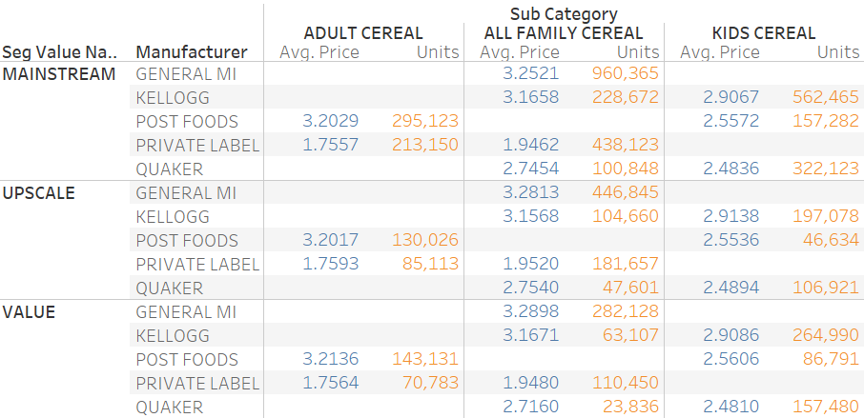

Sub-Category by Segment
SEGMENTING customers into three categories
Notes:
Kellogg’s also did well on segmenting. Kellogg’s segments stores into three categories based on the analysis of customer behaviors and sales when opening new stores.
This variable will also be considered later in the model.
#Value stores are designed to appeal to customers focused most on price.
#Upscale stores serve shoppers who place their primary emphasis on customer service.
#Mainstream stores serve the vast majority between those two extremes.

Slide 17

Price Setting

Slide 18
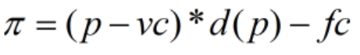
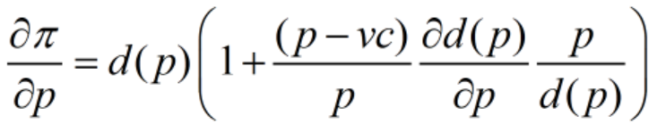
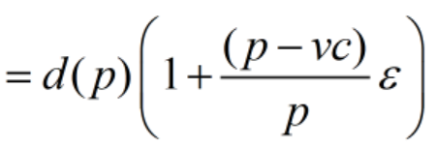
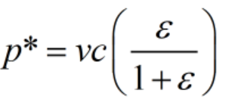
Profit Max Equation

Slide 19

Regression Analysis
Log - Log form
Other effects
Competitors prices
Geographic Information
Seasonality
→ log(Sales) = β0 + β1*log(Price) + β2*Competitors Prices +
β3*Geographic location + β3*Seasonality

Slide 20
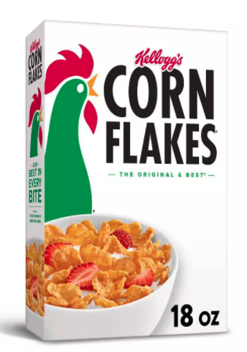
Family Cereal
Elasticity: -1.91
Optimal Price
P* = (Current price* 60%)* (-1.91/(1-1.91)) = $3.53

Slide 21
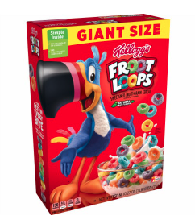
Kids Cereal
Elasticity: -2.41
Optimal Price
P* = (Current price* 60%)* (-1.91/(1-1.91)) = $2.87

Slide 22

Competitions
Family Cereal
Without: $3.532
With: $3.530
→ Bias: 0.063%
Kids Cereal
Without: $2.866
With: $2.873
→ Bias: 0.225%

Slide 23
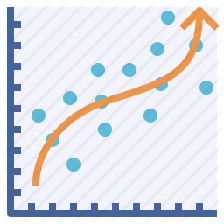
Modelling
& Prediction
Notes:
(skip) After we set the price for each sub-category, we’ll train a model that predicts the sales and estimate the expected profits using the price and other independent variables.

Slide 24
Modelling
Model Training Set: 2009-2010
Model Test Set: 2011-2012Jan
Modelling Method: Linear Regression
Dependent Variables: UNITS (demand)
Independent Variables:
Transaction Data: PRICE + FEATURE + DISPLAY
Store Data: ADDRESS_STATE_PROV_CODE + AVG_WEEKLY_BASKETS +
SEG_VALUE_NAME + PARKING_SPACE_QTY +
SALES_AREA_SIZE_NUM
Notes:
We split the whole dataset by time, with around 70% of training set and 30% of test set
We’re building a linear regression model with the UNITS as the dependent variable.
For the independent variables, we’re using the transaction data including ‘Price’, ‘Feature’, and ‘Display’
and also other store data that indicates the geographic factors.

Slide 25
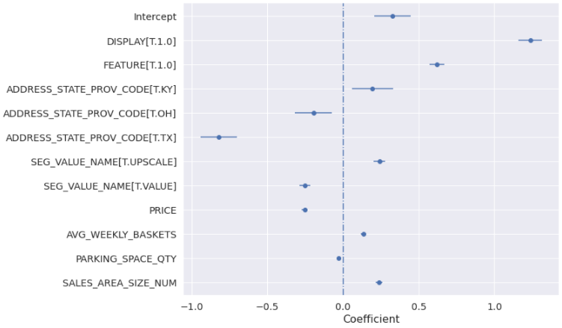
Family Cereal
R-squared = 0.605
Notes:
First, we created a model for the family cereal sub-category, and the numeric variables are all standardized.
The model has a R-squared value of around 0.6, which means that the model explains 60% of the variation in the dependent variable.
We can also see from the coefficient plot that the Display’ variable has the highest positive coefficient and the Texas state has the lowest coefficient.

Slide 26
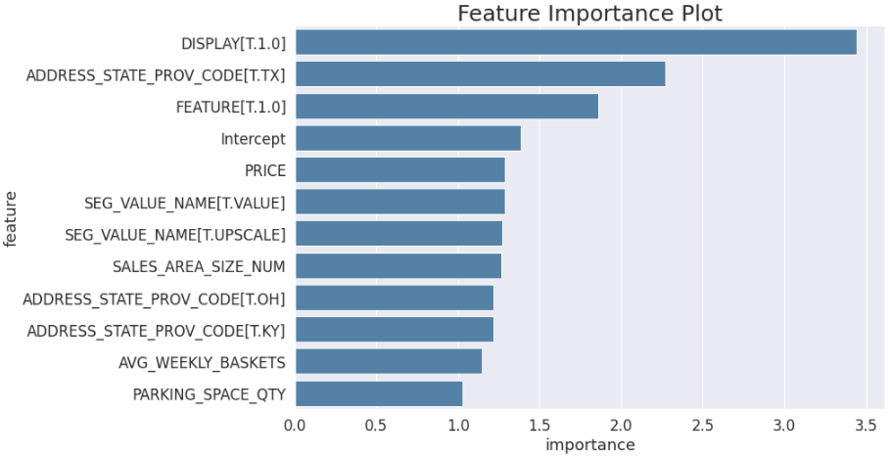
Family Cereal
Notes:
Next, we made the feature importance plot based on the odds ratio value and then sort the importance, no matter it’s a positive or negative effect.
(click) Here we see that the ‘Display’ variable really impact a lot on the sales for family cereal.
So this is something we can focus on when we’re initiating a marketing strategy, besides setting a price.

Slide 27
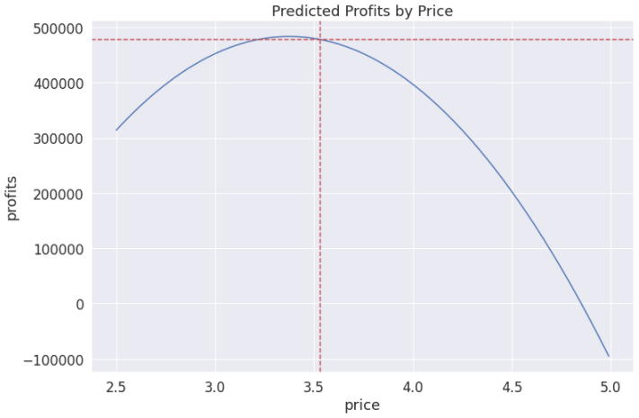
Family Cereal Profits Predictions
478218
COGS rate = 60%
Set Price = $3.53
Profits Increase
3.15%
3.53
Notes:
Now we make predictions on the profits by setting the price to $3.53, which is the price we got previously, and keep all other variables constant.
We’re predicting the profits using the whole dataset.
To calculate the profits, we made an assumption on the cost, which is 60% rate of the goods sold. We got this approximate rate from the 2009 annual financial statements report from Kellogg’s.
(click) Based on the set price, we can increase our profits by 3.15%

Slide 28
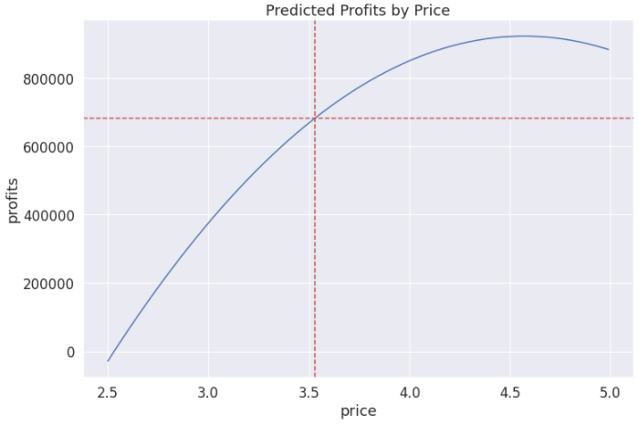
Family Cereal Profits Predictions (w/ Display)
682318
COGS rate = 80%
Set Price = $3.53
Profits Increase
47.18%
3.53
Notes:
What if we not only set the price but also make in-store display throughout the whole time?
Of course the marketing expense will increase substantially, so we increased the COGS rate assumption to 80%.
(click) Now the profits increased by about 47%, which is an impressive improvement, but keep in mind that this is the ideal situation since in reality
we’re not able to display our products all the time, so we have to make trade-offs and decide WHEN to display our products.

Slide 29
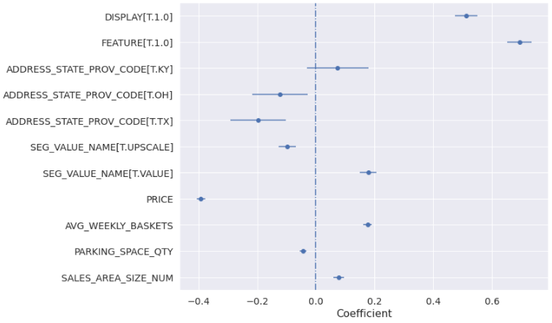
Kids Cereal
R-squared = 0.538
Notes:
We did the same thing for kids cereal, and the r-squared value is 53.8%, which is also not bad.
The model shows a higher coefficient on the ‘Feature’ variable, and the ‘Price’ has more negative impact on the sales.

Slide 30
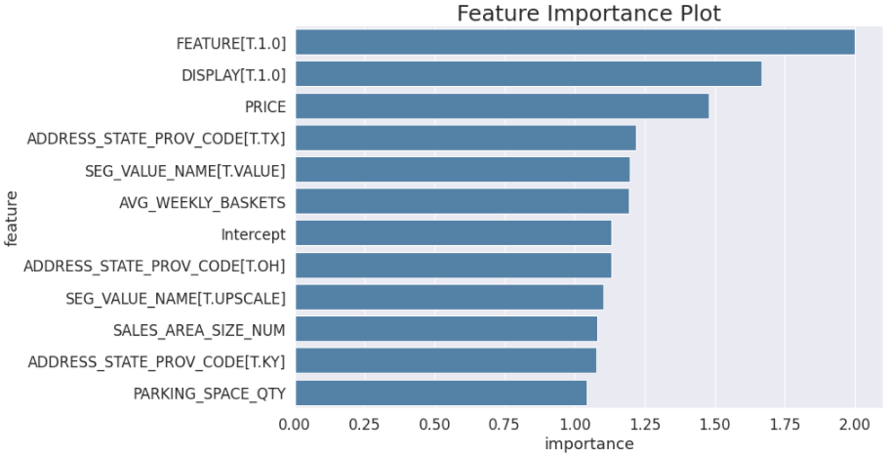
Kids Cereal
Notes:
The plot also shows that the ‘Feature’ variable has the most influence on the sales.
So different from family cereal, we can focus on featuring kids cereal as a marketing strategy.

Slide 31
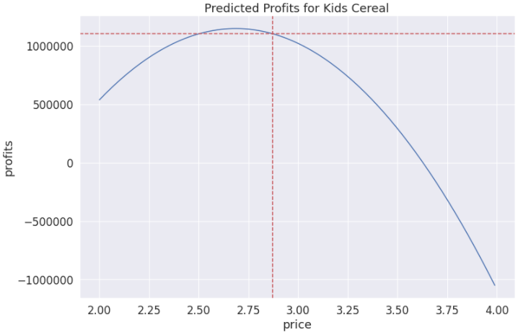
Kids Cereal Profits Predictions
1103970
COGS rate = 60%
Set Price = $2.87
Profits Increase
30.33%
2.87
Notes:
We set the kids cereal price to $2.87, and remain all other variables constant. The assumption on the COGS rate is still 60%.
(click) The expected profits increased substantially by about 30%

Slide 32
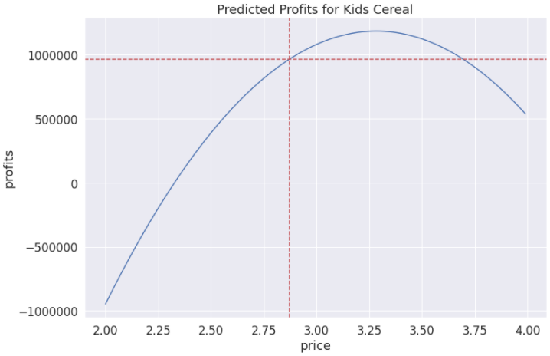
Kids Cereal Profits Predictions (w/ Feature)
963187
COGS rate = 80%
Set Price = $2.87
Profits Increase
13.71%
2.87
2.87
Notes:
What if we feature kids cereal in-store throughout the whole time? Is it also going to improve the profits even if with a higher cost?
(click) The answer is no! It still improves the profits, but the percentage of improvement drops from 30% to around 14%.
So again, it’s not reasonable to feature kids cereal in the whole year.

Slide 33
Results
Sub-Category | Price Setting | Marketing Strategy | COGS Rate | % of Profits Increase
Family Cereal | 3.53 | No Specify | 0.6 | 3.15%
 |  | In-store Display | 0.8 | 47.18%
Kids Cereal | 2.87 | No Specify | 0.6 | 30.33%
 |  | In-store Featuring | 0.8 | 13.71%
Notes:
Here is the consolidated table for the results. To sum up, the two models with the set price can improve the expected profits,
and we can improve even more when we conduct a marketing promotion strategy in some occasions.

Slide 34

Conclusion
Notes:
Finally, we will conclude our pricing strategies and a few ideas about what can be done better.

Slide 35


Pricing Strategy
Competitive
Pricing
Competitive
Pricing
Value
Pricing
Notes:
The current pricing strategy for Kellogg’s is mainly competitive pricing
(click) The major concept of our new pricing strategy is to not only consider the price from the competitors, but also include value pricing concepts,
such as the seasonality effect and the geographic information, to earn the differentiated worth of the product for a customer segment when compared to our competitors.

Slide 36

Pricing Strategy
In-store Display
Family Cereal
$3.49
$3.53
In-store Featuring
Kids Cereal
$2.87
$2.89
Notes:
First, we divided our pricing into two different sub-categories, (click) and then set the price by comparing with the competitors and customer value.
However, studies show that demand appears to increase with an ending digit of 9 on the price,
(click) so we can make slight adjustments on our set price.
(click) Finally, as mentioned before, we can perform promotion strategies for each sub-category to drive for more profits.

Slide 37
What can be Done Better?
Short-term v.s Long-term
Solid cost assumptions & additional marketing expense
Model Comparison (e.g. Neural Network, Random Forest)
Notes:
(click) First, it raises a flag that as time goes on, the historic dataset we used to set price and predict the profits would be outdated.
Therefore, the pricing we set should not be a long-term plan, and should be refreshed and remodeled constantly.
So we should define a time-frame of this set price
(click) We could do better on the cost assumptions by collecting more data and how we can include additional marketing expense to make solid predictions on profits.
(click) Finally, besides our regression model, we could try to build more models to compare the performance of our training and test set.

Slide 38
Thank you!

